Slide 1


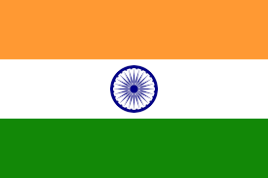




Analysing Top 50 Tracks Across Countries:
Unveiling the Factors Behind Popularity and Visualising Cross-Country Variations
Spotify
+

Slide 2
k
Upgrade
Group 7
Project Overview
Research Questions
Our Teams
Results
Are there any differences in the type of music being listened to across different English-speaking countries?
How do the audio features of the tracks contribute to the popularity of tracks? Does this change across different contexts?
Adaptation
Conclusions
Objectives
Using Spotify's API, obtain data for tracks in a total of 6 top 50 playlists.
Compare and contrast the top tracks across different countries and globally.
Analyse and visualise data on characteristics of the top tracks.
Identify any trends or patterns in music preferences between countries.
Explore any relationships between cultural factors and music preferences.
Notes:
The analysis of this project examines the 50 most streamed songs in different English-speaking countries by extracting data from Spotify’s API. Our goal with this project is to gain insight around the cultural and musical diversity, explore any patterns or correlations that may occur and what kind of characteristics contribute to a song’s popularity. These findings will be visualised in bar charts, scatters, line plots and word clouds to help understand the differences and similarities in music preferences across these five different countries.

Slide 3

Upgrade
Group 7
Project Overview
Our Teams
Our Teams
Results
Adaptation
Conclusions
Esther González-Hernando
Eziamaka Nwakile
Kaban Mohammadi
Man Zhang
Sarah Newlan-Lewis
Wei Lu

Slide 4
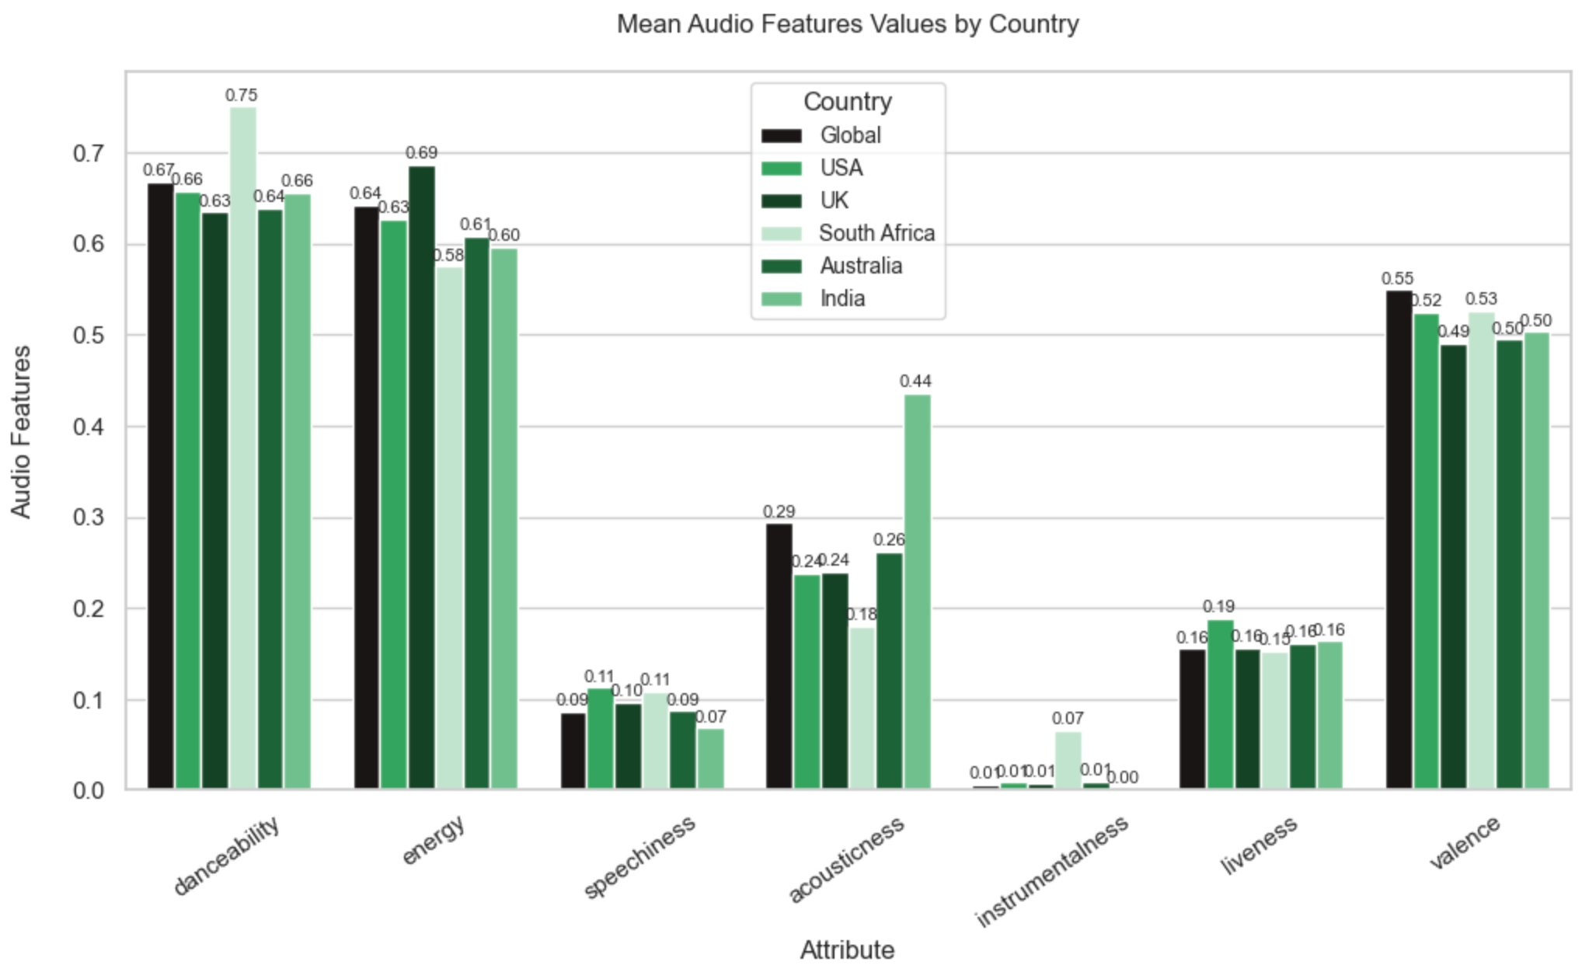
Upgrade
Group 7
Project Overview
Results
Our Teams
Results
The mean danceability of the top 50 songs in South Africa is 0.08 greater than the global mean.
The mean acoustic ness of the top 50 songs in India is 0.15 greater than the global mean.
The mean instrumentalities of the top 50 songs in South Africa us 0.07 above the global mean of 0.01.
Adaptation
Conclusions
Notes:
Top points- South Africa top 50 songs have higher danceability than the songs from the other countries, and the global
India top 50 songs have higher accousticness than the songs from the other countries, and the global
South Africa top 50 songs have higher instrumentalness than the songs from the other countries, and the global,
A bar chart to show the mean attribute values by countries.
The attribute values from the songs were calculated as floats by spotify for every song.
The danceability feature (float, 0-1) describes how suitable a track is for dancing based on a combination of musical elements including tempo, rhythm stability, beat strength, and overall regularity.
Energy feature (float, 0-1) represents a perceptual measure of intensity and activity. Typically, energetic tracks feel fast, loud, and noisy.
Speechiness feature (float, 0-1) detects the presence of spoken words in a track. The more exclusively speech-like the recording (e.g. talk show, audio book, poetry), the closer to 1.0 the attribute value.
Instrumentalness feature (float 0-1) Predicts whether a track contains no vocals. ("Ooh" and "aah" sounds are treated as instrumental in this context.) The closer the instrumentalness value is to 1.0, the greater likelihood the track contains no vocal content.
Acousticness- A confidence measure from 0.0 to 1.0 of whether the track is acoustic.
Liveness feature (float, 0-1) detects the presence of an audience in the recording. Higher liveness values represent an increased probability that the track was performed live.
Valence (float, 0-1) Tracks with high valence sound more positive (e.g. happy, cheerful, euphoric), while tracks with low valence sound more negative (e.g. sad, depressed, angry).

Slide 5
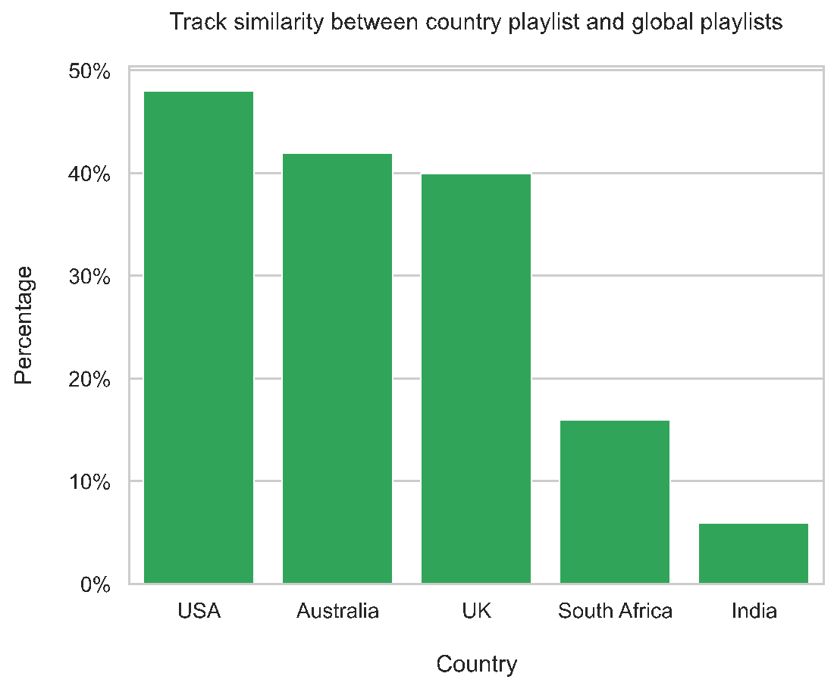
Upgrade
Group 7
Project Overview
Our Teams
Results
Adaptation
Conclusions
Notes:
A bar chart that shows the percentage of global top 50 songs that are in the top 50 songs for each country.
Top points- USA has the highest similarity to the global playlist (top 50 songs).
Australia and UK has similar similarity to the global playlist.
SA and India has very low similarity to the global playlist- for SA only 15% of the songs appeared in both the SA and global playlists. For India only 5% of the songs appeared in both the India and global playlists.
Eg, India and US have different music tastes- >40% difference in the countries track similarity to the global tracks.

Slide 6
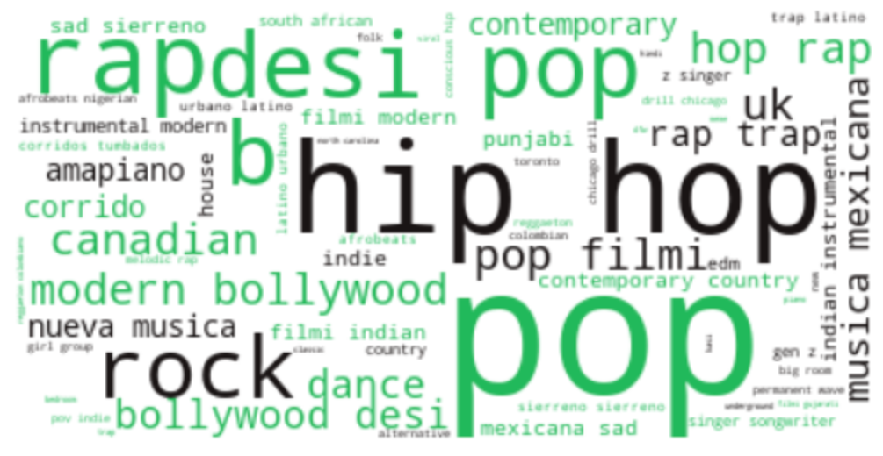
Upgrade
Group 7
Project Overview
Our Teams
Results
Adaptation
Conclusions
Notes:
Word cloud- quick mention.
This is a visualization of the genres of the top 50 songs from all 5 countries together. You can easily see that the most popular genres include pop, hip hop, and rap.

Slide 7
Adaptation and Overcoming Obstacles
Upgrade
Group 7
Project Overview
Our Teams
Results
Adaptation
TikTok API Accessibility:
Initially aimed to explore the impact of TikTok on song popularity in Spotify.
Limitation: TikTok's API only accessible to US researchers.
Solution: Shifted focus solely to Spotify analysis due to its accessible API.
Difficulties with Genre Extraction from Spotify:
Challenge: Difficulty in retrieving music genres for individual tracks.
Spotify provides genres for albums or artists, not individual tracks.
Attempted using album genres but encountered empty lists in datasets.
Solution: Successfully obtained genres by extracting them from the artists.
Conclusions

Slide 8
Upgrade
Group 7
Project Overview
Conclusions
Our Teams
Results
High level of similarity between global, UK, US and AUS playlists.
Top 50 songs in SA displayed a higher instrumentalness compared to the other countries.
Acousticness for the top 50 songs in IN far exceeds that of other countries.
Cultural and context-specific circumstances influence the type of music being listened to in each country.
Audio features did not have a strong influence on the popularity of tracks.
Adaptation
Conclusions
Notes:
Our overall conclusions
Copy from the final report one done, then edit, put some simple statements/prompts on the slide.
Correlation- NOT causation

Slide 9


Thank You
Data Analysis Is Fun!
Group 7
0:23
-3:25

